Slide 1
Building a REST API

Slide 2
Serializer (serializers.Serializer)
ModelSerializer (serializers.ModelSerializer)
ViewSets (ModelViewSet)
Routers (DefaultRouter)

Slide 3
DRF
DRF is an open source Python library that can be used to develop REST APIs for a Django project. DRF has most of the necessary functionality built in to help develop APIs for any Django project.
pip install djangorestframework
Project: company
App name: companyapp
INSTALLED_APPS = ['rest_framework’,]

Slide 4
models.py
class Employee(models.Model):
company = models.ForeignKey(Company,on_delete=models.CASCADE)
name = models.CharField(max_length=100)
email = models.EmailField()
salary = models.DecimalField(max_digits=10,decimal_places=2)
designation = models.CharField(max_length=100)
def __str__(self):
return self.name
from django.db import models
from django.db import models
class Company(models.Model):
name = models.CharField(max_length=100)
location = models.CharField(max_length=100)
founded_year = models.IntegerField()
def __str__(self):
return self.name

Slide 5
Views.py
from django.shortcuts import render
from rest_framework.decorators import api_view
from rest_framework.response import Response
from .models import Employee
from .serializers import EmployeeSerializer
@api_view(['GET'])
def first_api_view(request):
emp= Employee.objects.all()
employee_serializer = EmployeeSerializer(emp, many=True)
return Response(employee_serializer.data)

Slide 6
serializers
if we wanted to return the full details about an actual book in our database with our API? DRF's serializer class helps to convert complex Python objects into formats such as JSON or XML so that they can be transmitted across the web using the HTTP protocol.

Slide 7
Creating an API view to display a list of books
1. Create a file named serializers.py in the companyapp folder. This is the file where we will place all the serializer code for the APIs.
2. Add the following code to serializers.py:
from rest_framework import serializers
class CompanySerializer(serializers.Serializer):
id = serializers.IntegerField(read_only=True)
name = serializers.CharField(max_length=100)
location = serializers.CharField(max_length=100)
founded_year = serializers.IntegerField()

Slide 8
serializers.py
class EmployeeSerializer(serializers.Serializer):
id = serializers.IntegerField(read_only=True)
company = CompanySerializer()
name = serializers.CharField(max_length=100)
email = serializers.EmailField()
salary = serializers.DecimalField(max_digits=10,decimal_places=2)
designation = serializers.CharField(max_length=100)

Slide 9
Company/urls.py
from django.contrib import admin
from django.urls import path,include
urlpatterns = [ path('admin/', admin.site.urls),
path("", include('companyapp.urls')),
]

Slide 10
Companyapp/urls.py
from django.contrib import admin
from django.urls import path,include
from . import views
urlpatterns = [ path("", views.first_api_view),]
Python manage.py runserver

Slide 11
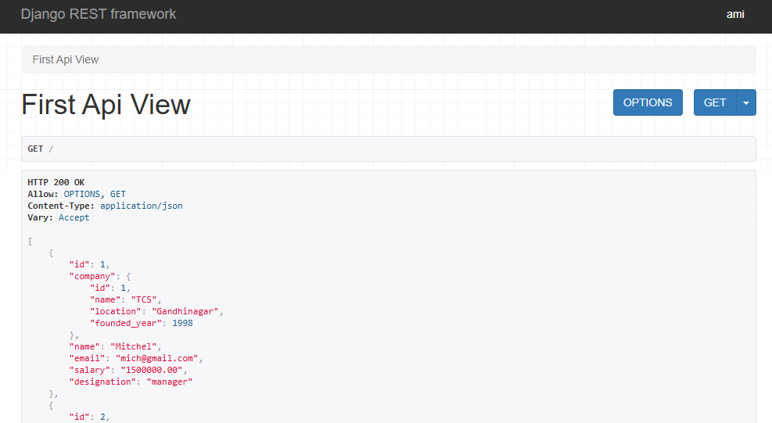
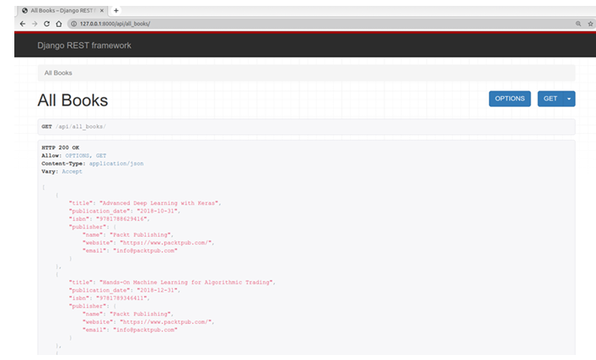

Slide 12
serializers.py using ModelSerializer(make change in serializers.py) ModelSerializer automatically creates serializer fields from the Django model.
from rest_framework import serializers
from .models import Company, Employee
class CompanySerializer(serializers.ModelSerializer):
class Meta:
model = Company
fields = "__all__"
class EmployeeSerializer(serializers.ModelSerializer):
company = CompanySerializer(read_only=True)
class Meta:
model = Employee
fields = "__all__"

Slide 13
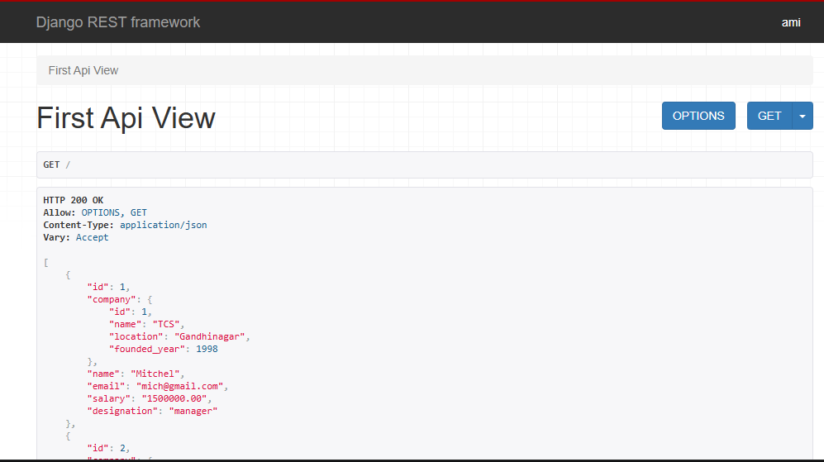

Slide 14
Simplifying the code using ViewSets
ViewSets and routers help us sing class-based further simplify our code. As the name indicates,
ViewSets are a set of views represented in a single class.

Slide 15
views.py
from rest_framework import viewsets
from .models import Company, Employee
from .serializers import (CompanySerializer,EmployeeSerializer)
class CompanyViewSet(viewsets.ModelViewSet):
queryset = Company.objects.all()
serializer_class = CompanySerializer
class EmployeeViewSet(viewsets.ModelViewSet):
queryset = Employee.objects.all()
serializer_class = EmployeeSerializer

Slide 16
Companyapp/urls.py
from django.urls import path, include
from rest_framework.routers import DefaultRouter
from .views import ( CompanyViewSet, EmployeeViewSet)
router = DefaultRouter()
router.register( 'companies', CompanyViewSet)
router.register('employees', EmployeeViewSet)
urlpatterns = [ path( '', include(router.urls) ),]

Slide 17
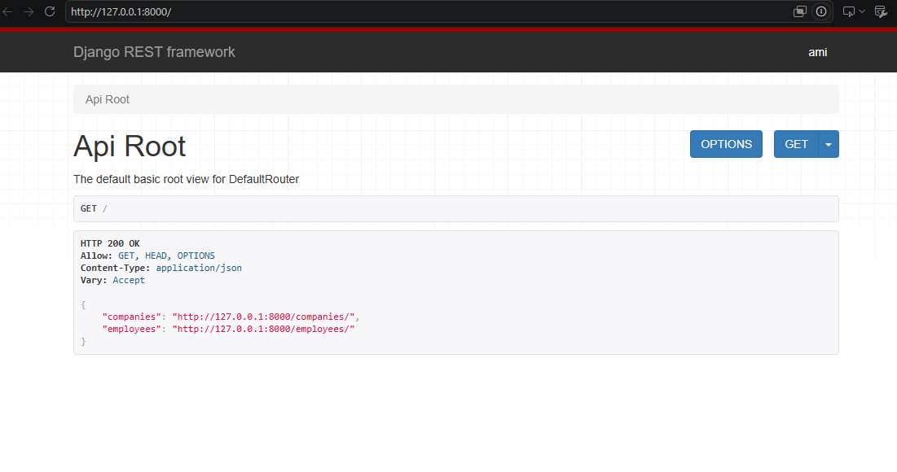

Slide 18
